Slide 1
Foundations of Bitcoin and Blockchain Technologies
Risman Adnan Mattotorang, Ph.D
Telkom University

Slide 2
What You Learnt Last Week
History of Money
History of Cryptocurrency
Satoshi Nakamoto Paper
Basic Concepts in Cryptography

Slide 3
What Will You Learn Today
The Core Components
Hash Function
Merkle Tree
Digital Signature
Public Key as Identity
Simple Cryptocurrency

Slide 4
Hash Function

Slide 5
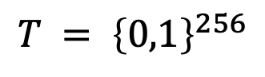
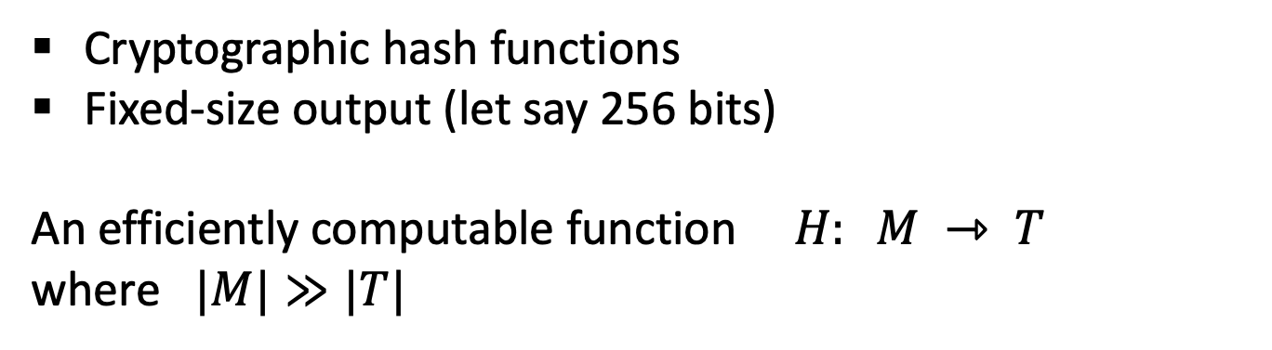
Cryptography Background
Cryptographic hash functions
Fixed-size output (let say 256 bits)
An efficiently computable function $H: M ⇾ T$
where $|M|≫|T|$
32 bytes
megabytes
hash value
$$T = {\left\{0,1\right\}}^{256}$$

Slide 6
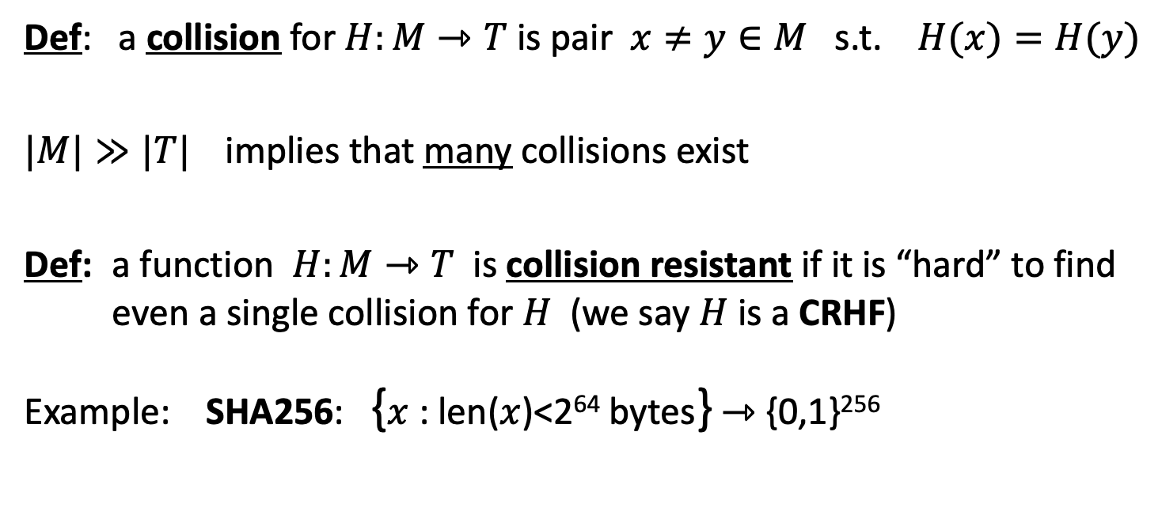
Hash Property 1: Collision Free
Def: a collision for $H:M⇾T$ is pair $x≠y∈M$ s.t. $H(x)=H(y)$
$|M|≫|T|$implies that many collisions exist
Def: a function $H:M⇾T$ is collision resistant if it is “hard” to find even a single collision for $H$ (we say $H$ is a CRHF)
Example: SHA256: {$x$ : len($x$)<2⁶⁴ bytes} ⇾ {0,1}²⁵⁶

Slide 7
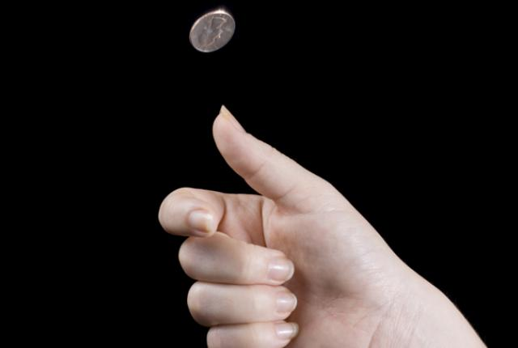
Hash Property 2: Hiding
Given H(x), it is infeasible to find x. Hiding property:
If r is chosen from a probability distribution that has high min-entropy, then given H(r | x), it is infeasible to find x. High min-entropy means that the distribution is “very spread out”, so that no particular value is chosen with more than negligible probability.
H(“heads”)
easy to find x!
H(“tails”)

Slide 8
Application: Commitment API
Want to “seal a value in an envelope”, and “open the envelope” later.
Commit to a value, reveal it later.
Security properties: hiding and binding.
(com, key) := commit(msg)
match := verify(com, key, msg)
To seal msg in envelope:
(com, key) := commit(msg) -- then publish com
To open envelope:
publish key, msg
anyone can use verify() to
check validity

Slide 9
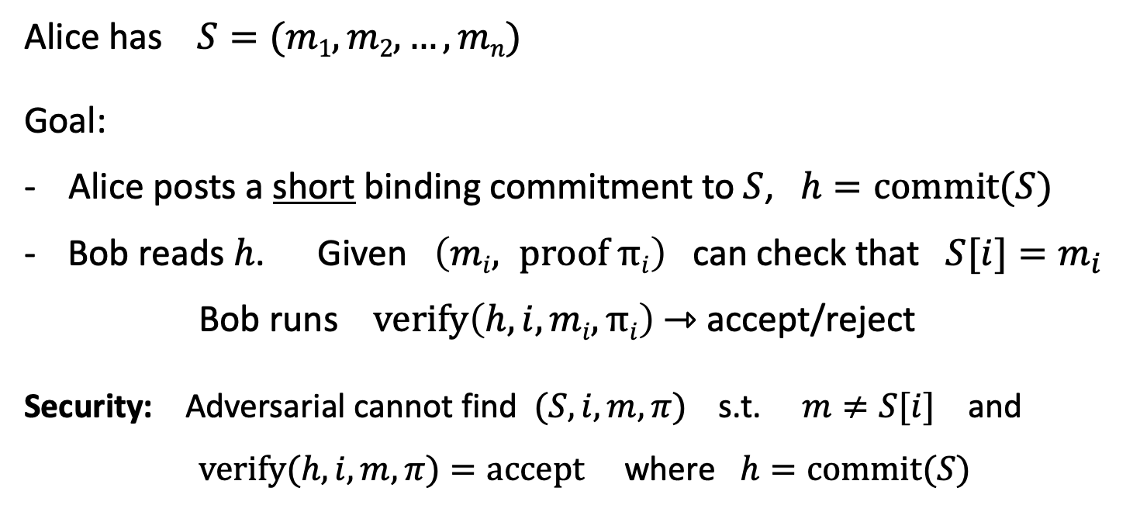
Application: Commitment API
32 bytes
Alice has $S=(m1,m2, …,mn)$
Goal:
- Alice posts a short binding commitment to $S$, $h=commit(S)$
Bob reads $h$. Given $\left(mi, proof πi\right)$ can check that $S[i]=m_{i}$
Bob runs $verify\left(h, i, mi, πi\right)$ ⇾ accept/reject
Security: Adversarial cannot find $(S, i, m, π)$s.t. $m≠S[i]$ and $verify(h,i,m,π)=accept$where $h=commit(S)$

Slide 10
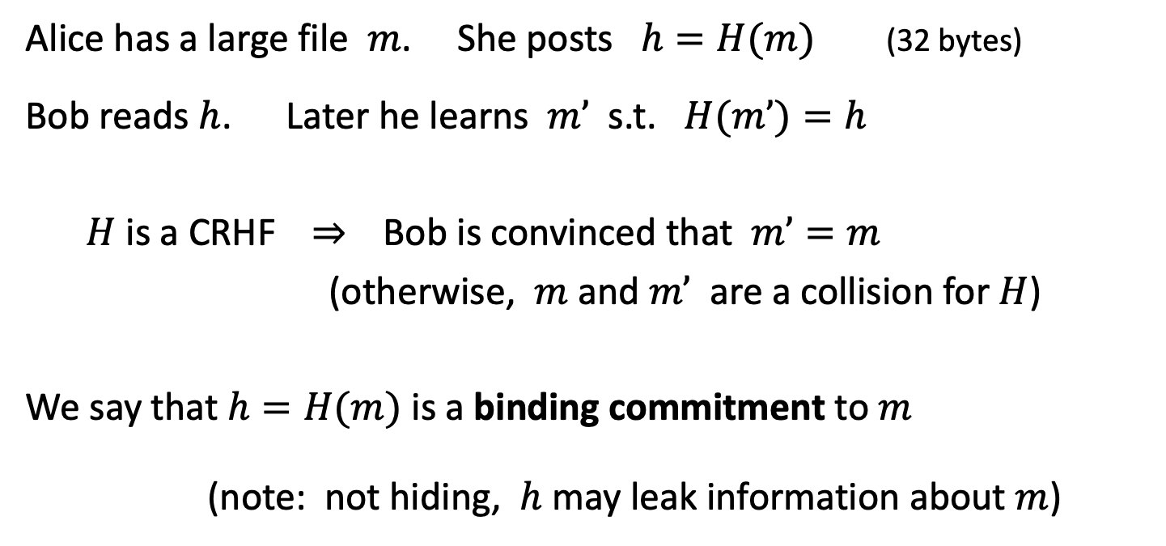
Application: Commitment API
Alice has a large file $m$. She posts $h=H(m)$(32 bytes)
Bob reads $h$. Later he learns $m’$ s.t. $H(m’)=h$
$H$ is a CRHF ⇒ Bob is convinced that $m’=m$
(otherwise, $m$ and $m’$ are a collision for $H$)
We say that $h=H(m)$ is a binding commitment to $m$
(note: not hiding, $h$ may leak information about $m$)
Notes:
Alice posts hash h on the blockchain.

Slide 11
Hash Property 3: Puzzle-Friendly
Puzzle-friendly:
For every possible output value y,
if k is chosen from a distribution with high min-entropy,
then it is infeasible to find x such that H(k | x) = y.
Puzzle-friendly property implies that no solving strategy is much better than trying random values of x.

Slide 12
SHA-256 Hash Function
Padding (10* | length)
512 bits
Message
(block 1)
Message
(block 2)
Message
(block n)
256 bits
256 bits
c
c
c
IV
Hash
Theorem: If c is collision-free, then SHA-256 is collision-free.

Slide 13
Hash Pointer & Merkle Tree

Slide 14
Hash Pointer
Hash Pointer is:
* Pointer to where some info is stored, and
* Cryptographic hash of the info
If we have a Hash Pointer, we can
* Ask to get the info back, and
* Verify that it hasn’t changed
H( )
(data)
will draw hash pointers like this

Slide 15
Key Idea
Build cycle-free data structures with hash pointers
Linked list with Hash Pointers = “block chain”
Use Case: Tamper-Evident Log (Detecting Tampering)
H( )
prev: H( )
prev: H( )
prev: H( )
data
data
data

Slide 16
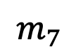
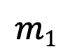
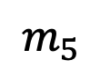

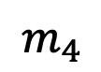
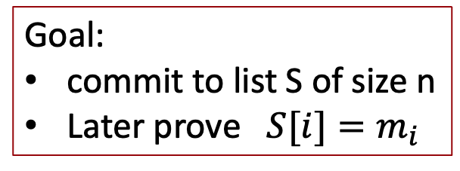
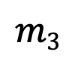
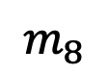
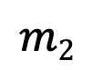
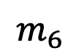
Merkle Tree (Merkle 1989)
commitment
$$h$$
Goal:
commit to list S of size n
Later prove $S[i]=m_{i}$
Merkle tree commitment
$$m1$$
$$m2$$
$$m3$$
$$m_{4}$$
$$m_{5}$$
$$m_{6}$$
$$m_{7}$$
$$m_{8}$$
list of values S

Slide 17
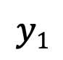
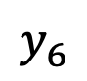
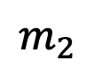
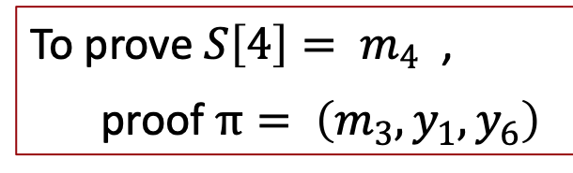
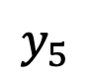
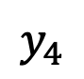
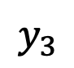

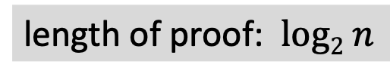
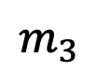
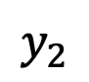
Merkle Tree (Merkle 1989)
commitment
$$h$$
Goal:
commit to list S of size n
Later prove $S[i]=m_{i}$
$$y_{5}$$
H
$$y_{6}$$
H
H
$$y1$$
$$y_{2}$$
$$y_{3}$$
$$y_{4}$$
To prove ${S\left[4\right]= m}_{4}$ ,
proof $π= \left(m_{3}, y_{1}, y_{6}\right)$
H
H
H
H
$$m1$$
$$m_{2}$$
$$m_{3}$$
$$m_{4}$$
$$m_{5}$$
$$m_{6}$$
$$m_{7}$$
$$m_{8}$$
length of proof: $log2 n$
list of values S

Slide 18
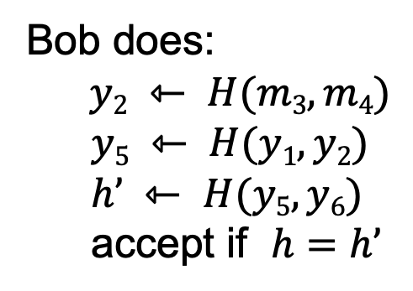
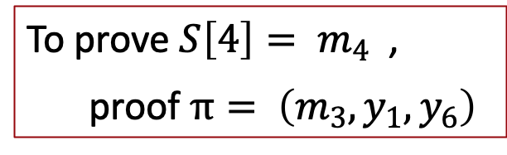
Merkle Tree (Merkle 1989)
commitment
$$h$$
To prove ${S\left[4\right]= m}_{4}$ ,
proof $π= \left(m_{3}, y_{1}, y_{6}\right)$
$$y_{5}$$
H
$$y_{6}$$
H
H
Bob does:
$y2 ⇽ H(m3,m4)$
$$y5 ⇽ H(y1, y2)$$
$$h’ ⇽ H(y5, y6)$$
accept if $h=h’$
$$y1$$
$$y_{2}$$
$$y_{3}$$
$$y_{4}$$
H
H
H
H
$$m1$$
$$m_{2}$$
$$m_{3}$$
$$m_{4}$$
$$m_{5}$$
$$m_{6}$$
$$m_{7}$$
$$m_{8}$$
list of values S

Slide 19
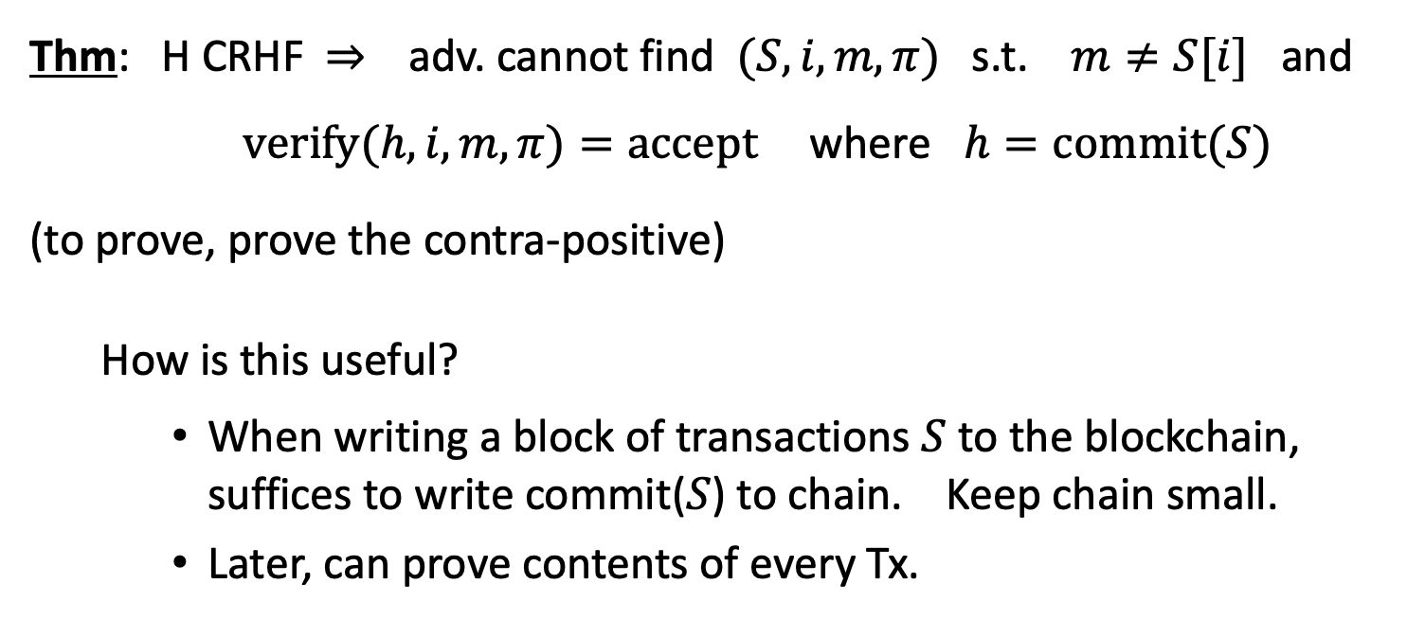
Merkle Tree (Merkle 1989)
Thm: H CRHF ⇒ adv. cannot find $(S, i, m, π)$s.t. $m≠S[i]$ and $verify(h,i,m,π)=accept$where $h=commit(S)$
(to prove, prove the contra-positive)
How is this useful?
When writing a block of transactions $S$ to the blockchain, suffices to write commit($S$) to chain. Keep chain small.
Later, can prove contents of every Tx.
Super useful. Example

Slide 20
Advantages of Merkle Trees
Holds many items but just need to remember the root hash
Can verify membership in O(log n) time/space
Variant: sorted Merkle tree
Can verify non-membership in O(log n)
Show items before, after the missing one

Slide 21
Digital Signature

Slide 22
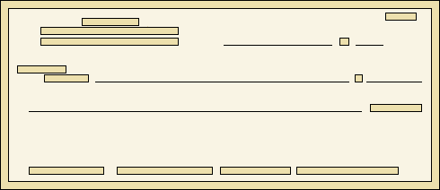
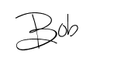
Signatures
Physical signatures: bind transaction to author
Only you can sign but anyone can verify
Signature is tied to a particular document
Bob agrees to pay Alice 100$
Bob agrees to pay Alice 1$
Problem in the digital world:
Anyone can copy Bob’s signature from one doc to another
Notes:
Bad example: will see why on the last slide of this segment.

Slide 23
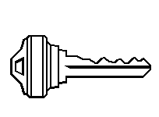
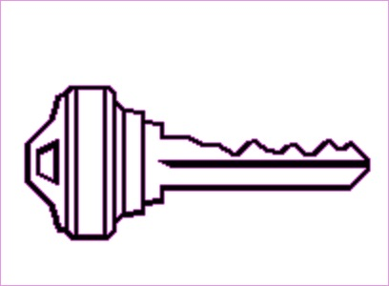
Digital Signatures
Solution: Make signature depend on document
Signer
Verifier
‘accept’
or
‘reject’
Bob agrees to pay Alice 1$
verifier
signature
signing
algorithm
secret signing key (sk)
public verification key (pk)

Slide 24
Digital Signatures: Syntax
Def: A Signature scheme is a triple of algorithms:
Gen(): outputs a key pair (pk, sk)
Sign(sk, msg) outputs sig. σ =Sign(sk, msg)
Verify(pk, msg, σ) outputs ‘accept’ or ‘reject’
isValid := Verify(pk, msg, σ)
Secure signatures: (informal)
Adversary who sees signatures on many messages of his choice, cannot forge a signature on a new message.
sk = Secret signing Key
pk = Public verification key
Algorithm can be randomized

Slide 25
Requirement of Signatures
“Valid signatures verify”
Verify(pk, msg, Sign(sk, msg)) == true
“Can’t forge signatures”
Adversary who:
knows pk
gets to see signatures on messages of his choice
can’t produce a verifiable signature on another message

Slide 26
Families of signature schemes
RSA signatures (old … not used in blockchains):
long sigs and public keys (≥256 bytes), fast to verify
Discrete-log signatures: Schnorr and ECDSA
short sigs (48 or 64 bytes) and public key (32 bytes)
BLS signatures: 48 bytes, aggregatable, easy threshold
Post-quantum signatures: long (≥768 bytes)
(Bitcoin, Ethereum)
(Ethereum 2.0, Chia, Dfinity)

Slide 27
Public Key as Identity

Slide 28
Signatures on the blockchain
Signatures are used everywhere:
ensure Tx authorization,
governance votes,
consensus protocol votes.
verifyTx
verifyTx
verify Tx
sk₁
data
signatures
sk₂
data
signatures

Slide 29
Useful Trick
In Blockchain Public Key = Identity (address in Bitcoin)
If you see Verify(pk, msg, Sign(sk, msg)) == true
Then think of it as pk says, “[msg]”.
To speak for pk, you must know secret key sk
Decentralized Identity Management:
Anyone can make new identity at any time
Make as many as you want!
No central point of coordination

Slide 30
How to Make New Identity
Create a new, random key-pair (sk, pk)
pk is the public “name” you can use
[usually better to use Hash(pk)]
sk lets you “speak for” the identity
You control the identity, because only you know sk
if pk “looks random”, nobody needs to know who you are
Identity is not directly connected to real-world,
but observer can make inference… We will learn Privacy in Blockchain

Slide 31
Simple Cryptocurrency

Slide 32

Goofy can create new coins
New coins belong to me.
signed by pk_{Goofy}
CreateCoin [uniqueCoinID]
GoofyCoin

Slide 33
A coin’s owner can spend it.
Alice owns it now.
signed by pk_{Goofy}
Pay to pk_{Alice} : H( )
signed by pk_{Goofy}
CreateCoin [uniqueCoinID]

Slide 34

The recipient can pass on the coin again.
signed by pk_{Alice}
Bob owns it now.
Pay to pk_{Bob} : H( )
signed by pk_{Goofy}
Pay to pk_{Alice} : H( )
signed by pk_{Goofy}
CreateCoin [uniqueCoinID]

Slide 35
Double Spending Attack
signed by pk_{Alice}
signed by pk_{Alice}
Pay to pk_{Bob} : H( )
Pay to pk_{Chuck} : H( )
signed by pk_{Goofy}
Pay to pk_{Alice} : H( )
The main problem in digital currency that is solved my Satoshi Nakamoto proposal.
signed by pk_{Goofy}
CreateCoin [uniqueCoinID]

Slide 36
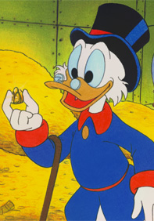
Scrooge publishes a history of all transactions
(a block chain, signed by Scrooge)
H( )
ScroogeCoin
prev: H( )
prev: H( )
prev: H( )
transID: 71
transID: 72
transID: 73
trans
trans
trans
Optimization: put multiple transactions in the same block

Slide 37
CreateCoins transaction creates new coins
Valid, because I said so.
transID: 73 type:CreateCoins
coins created
num | value | recipient
0 | 3.2 | 0x...
1 | 1.4 | 0x...
2 | 7.1 | 0x...
coinID 73(0)
coinID 73(1)
coinID 73(2)

Slide 38
PayCoins transaction consumes (and destroys) some coins,
and creates new coins of the same total value
transID: 73 type:PayCoins
consumed coinIDs:
68(1), 42(0), 72(3)
Valid if:
-- consumed coins valid,
-- not already consumed,
-- total value out = total value in, and
-- signed by owners of all consumed coins
coins created
num | value | recipient
0 | 3.2 | 0x...
1 | 1.4 | 0x...
2 | 7.1 | 0x...
signatures

Slide 39
Immutable Coins
Coins can’t be transferred, subdivided, or combined.
But: you can get the same effect by using transactions
to subdivide: create new trans
consume your coin
pay out two new coins to yourself
Don’t worry, I’m honest.
Crucial Question: Can we descroogify the currency, and operate without any central, trusted party?

Slide 40
Summary of This Lecture
Hash Function: Crypto Element of Bitcoin
Hash Pointer: Key Idea of Data Structure
Merkle Tree: Data Structured Used in Bitcoin
Digital Signature: Foundation of Tx in Bitcoin
Public Key: User Identity in Bitcoin
You can make your own Coin

Slide 41
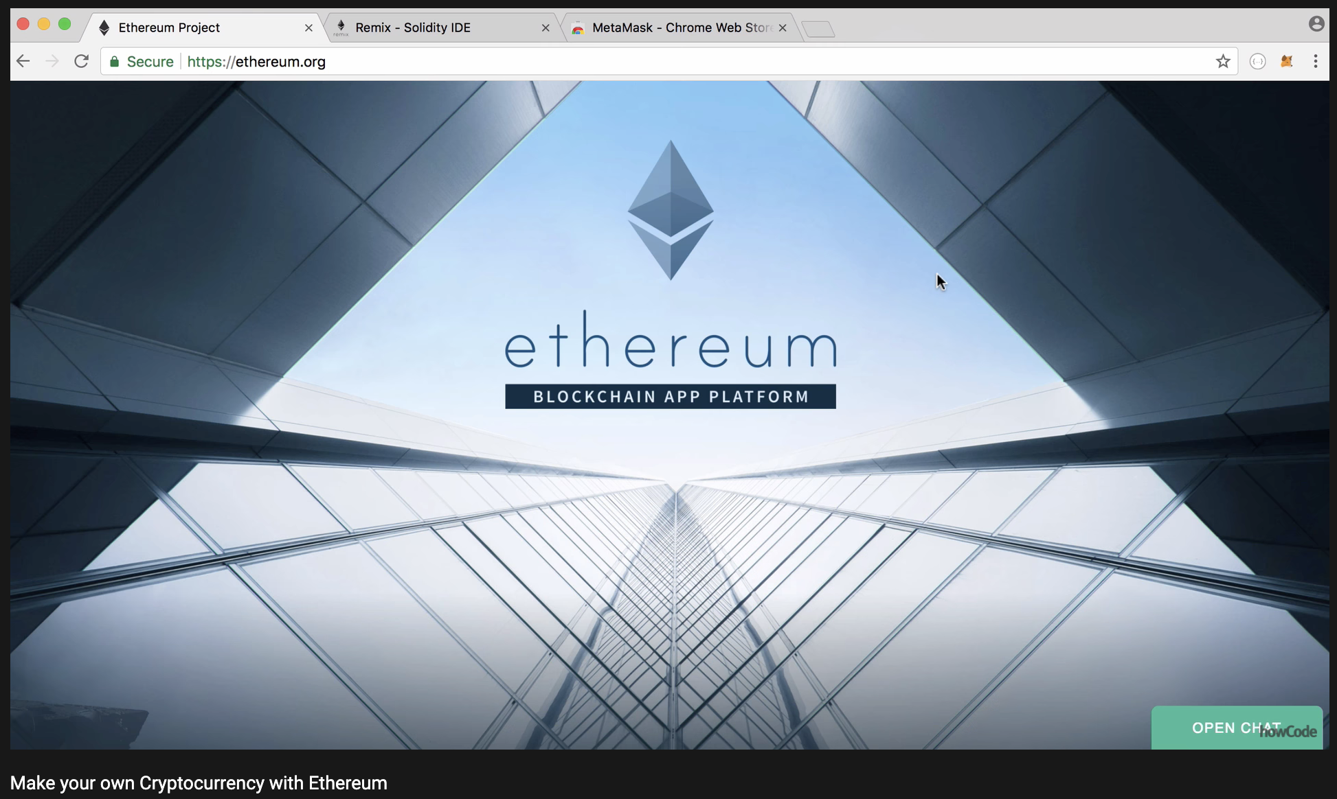
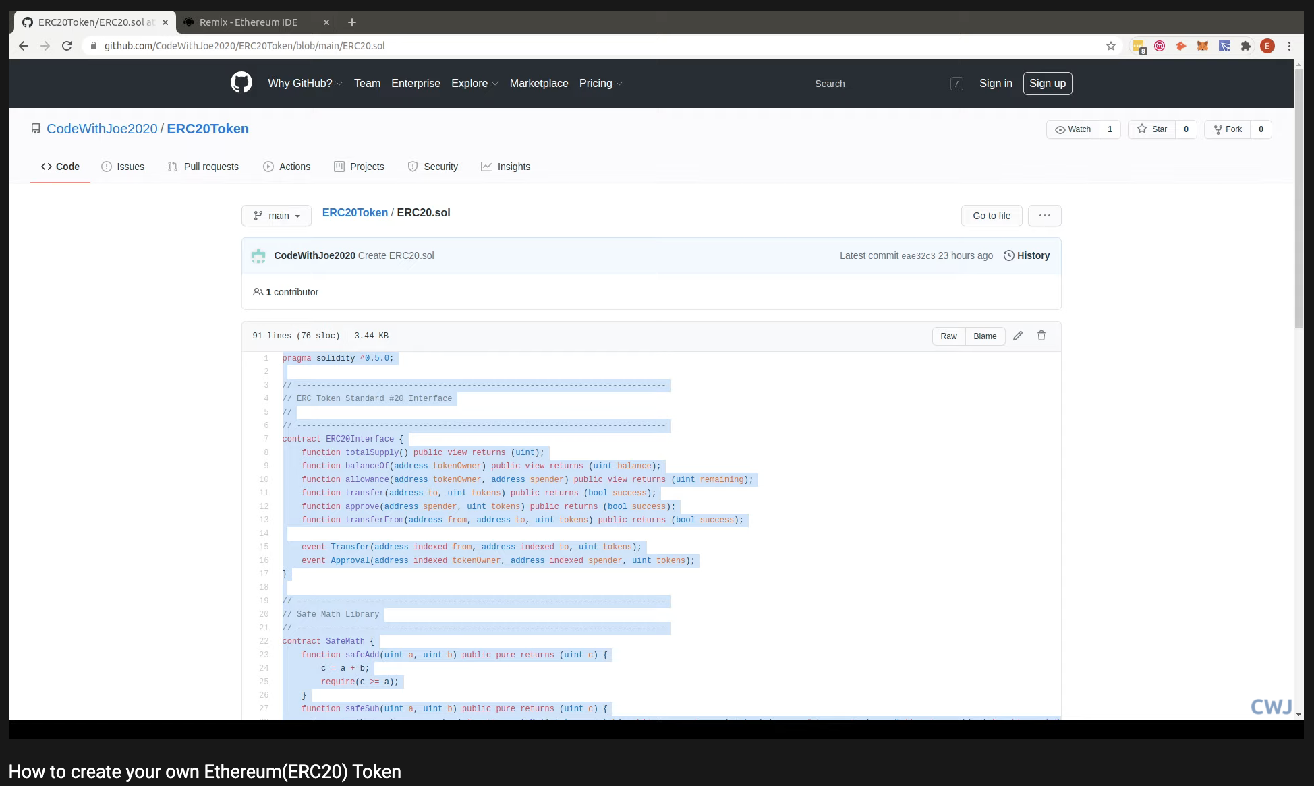
W2 Home Work
Your Hello-world for Ethereum Coin
Create Your Own Cryptocurrency with Ethereum!
More concepts you will learn soon! Its OK if you don’t get it yet.
https://www.youtube.com/watch?v=HT84tmymPaQ&t=418s
https://www.youtube.com/watch?v=GDq7r1n9zIU

Slide 42
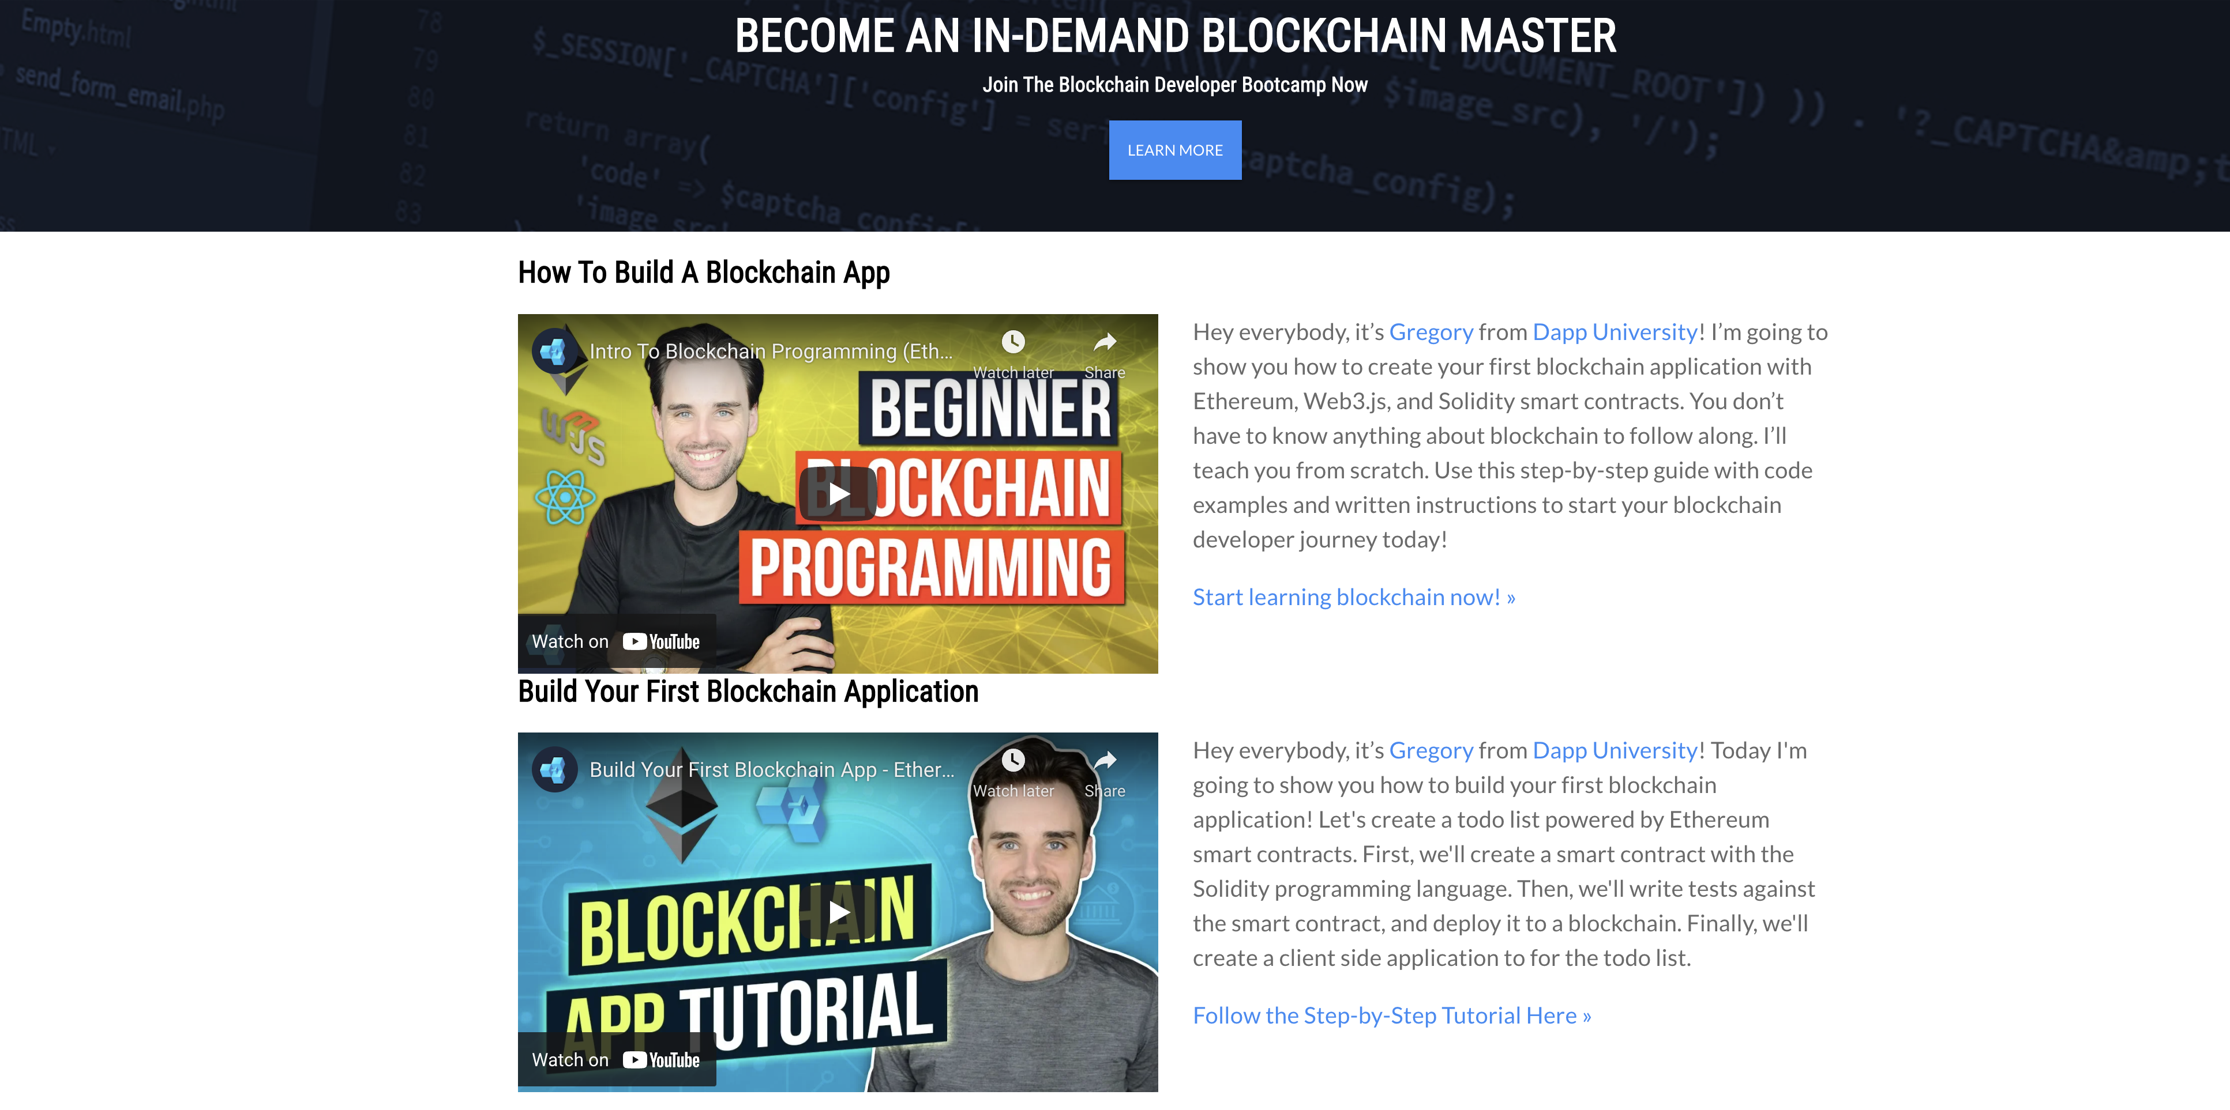
DApps University Resources
Learn more from here: https://www.dappuniversity.com/

